Slide 1



Patrice Cooper
7/ 31/ 02
BORING

Slide 2

People from Artemis
Erika Allie, Anna, Caitlin,
Jen Carla, Duckie, Haley,
Leah Hong, Judy, Latoya,
Sue Melanie, Mila, Nancy,
(coordinates) Nawar, Nina, Patrice,
Sarah, Selvana, Teonna, Willynn
(Students)
And these are all the girls from Artemis.

Slide 3
Words that would describe me.
Funny
Lovable
Curious
Happy

Slide 4
Friends from Artemis.
Judy B.
La’toya M.
Willynn S.
Anna V.

Slide 5


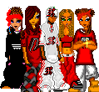

Girls from Artemis.
Mila, Hong, Nancy, Duckie,Caitlin, Haley Melanie, Allie, Nawar,Nina,
Carla, Sarah, Selvana, Teonna. ?????
Jen, Sue, Erika, Leah. Latoya, Patrice, Willynn,
Judy, Anna

Slide 6
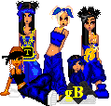
The Next Fly Girls.
Me and my girls chillin (ME, Latoya, Anna, Judy, Willynn).

Slide 7




My Family.
Dominique Candia, Alex
Essence
Lissa

Slide 8




My Family 2.
Amani Amaya
Deajnay Deonie

Slide 9

My Family 3.
My Foxy Mother (Benita).

Slide 10

My Family 4.
My Playa Brotha Andre.

Slide 11



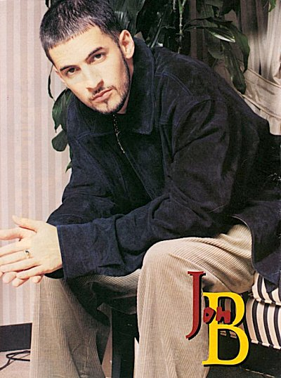
My Husbands Fa Life.
Slyvester
Bart Simpson
Jon B. Homer Simpson

Slide 12

The Cape Verdean Flag.

Slide 13

Meeeeeeeeeeeeeeeee
This me (Patrice).

Slide 14
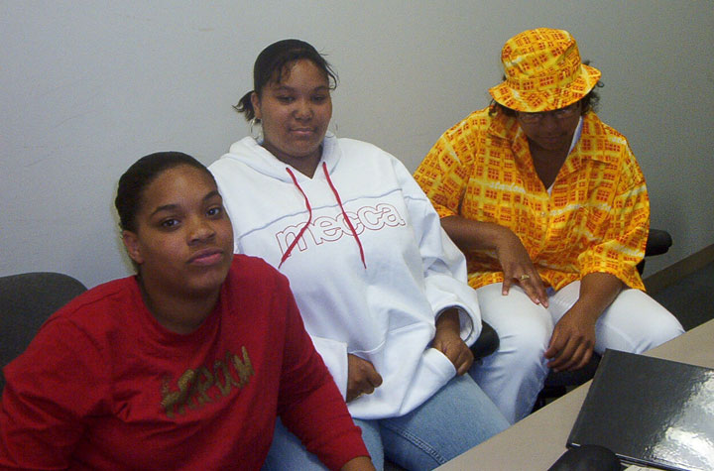
Judy, Latoya, Patrice.

Slide 15
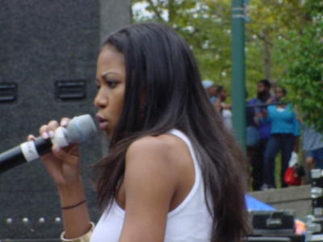
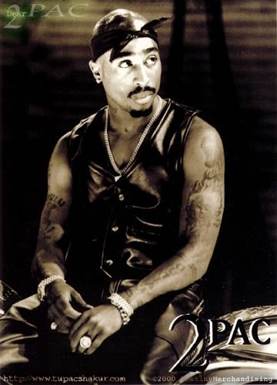
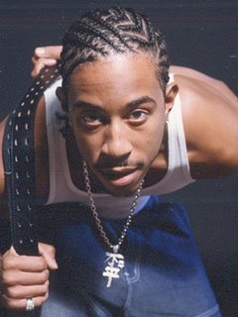
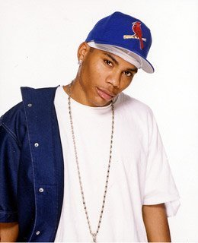
Favorite Artist.
Amerie Tupac (R.I.P)
Ludacris Nelly

Slide 16

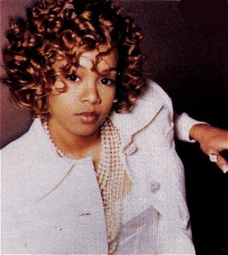
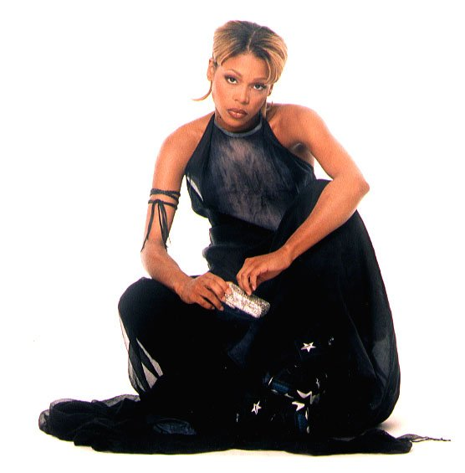

TLC
Left Eye (R.I.P) The group
The group T~Boz

Slide 17

Aaliyah(R.I.P)

Slide 18
My Favorite Sayings.
Nah I’ll pass.
Stopppppp.
Meowwwwwww.
I don’t think so.
I’m Bored.
That ain’t fair.

Slide 19
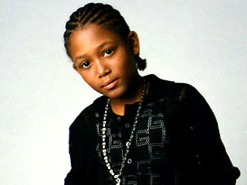

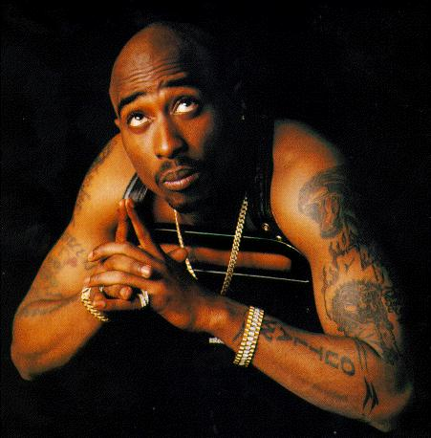
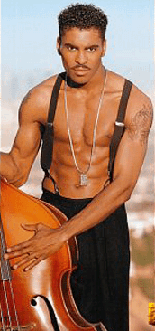
Other Husbands.

Slide 20
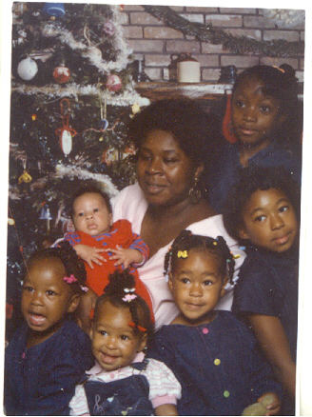
My Family.
Mother(Benita),Brother(An-
dre, Sisters(Essence, Lissa,
Dominique, Candia, and
Patrice.)

